Slide 1
UNIT II DIVIDE AND CONQUER
Session – 13

Slide 2
Syllabus
Introduction, Binary Search - Merge sort and its algorithm analysis - Quick sort and its algorithm analysis - Strassen's Matrix multiplication - Finding Maximum and minimum - Algorithm for finding closest pair - Convex Hull Problem

Slide 3
Introduction
Divide / Break
Conquer / Solve
Merge / Combine

Slide 4
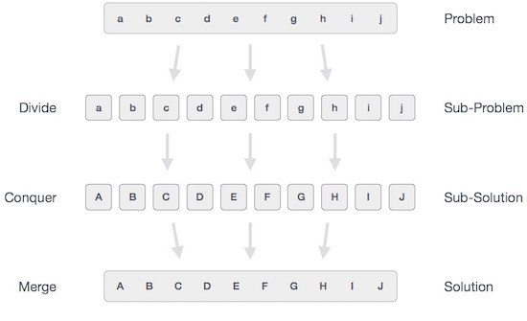

Slide 5
Finding Maximum and Minimum
Algorithm straightforward
Finding the maximum and minimum elements in a set of (n) elements
Algorithm straightforward (a, n, max, min)
Input: array (a) with (n) elements
Output: max: max value, min: min value
max = min = a(1)
for i = 2 to n do
begin
if (a(i)>max) then max=a(i)
if (a(i)<min) then min=a(i)
end
End
Complexity
best= average =worst= 2(n-1) comparisons

Slide 6
Modify it for betterment
If we change the body of the loop as follows:
max=min=a(1)
for i=2 to n do
begin
if (a(i)>max) then max=a(i)
else if (a(i)<min) then min=a(i)
end
Complexity
best case: elements in increasing order No. of comparisons = (n-1)
Worst case: elements in decreasing order No. of comparisons = 2(n-1)
Average case: a(i) is greater than max half the time
No. of comparisons = 3n/2 – 3/2
=(1/2)((n-1)+(2n-2))

Slide 7
Divide and Conquer approach
Problem: is to find the maximum and minimum items in a set of (n) elements.
Algorithm MaxMin(i, j, max, min)
input: array of N elements, i lower bound, j upper bound
output: max: largest value; min: smallest value.
if (i=j) then max=min=a(i)
else if (i=j-1) then
if (a(i)<a(j)) then max= a(j) and min= a(i)
else max= a(i) and min= a(j)
else
mid=(i+j)/2
maxmin(i, mid, max, min)
maxmin(mid+1, j, max1, min1)
if (max<max1) then max = max1
if (min>min1) then min = min1
end

Slide 8
 |  |  | 56 | 34 | 12 | 1 | 76 | 34 | 23 | 8 | 16
 | 56 | 34 | 12 | 1 |  |  |  | 76 | 34 | 23 | 8 | 16
56 | 34 |  |  | 12 | 1 |  | 76 | 34 |  |  | 23 | 8 | 16
Min | 34 |  |  | Min | 1 |  | Min | 34 |  | 23 |  | 8 | 16
Max | 56 |  |  | Max | 12 |  | Max | 76
 |  |  |  |  |  |  |  |  | Min | 23 |  | Min | 8
 |  | Min | 1 |  |  |  |  |  | Max | 23 |  | Max | 16
 |  | Max | 56
 |  |  |  |  |  |  |  |  |  |  | Min | 8
 |  |  |  |  |  |  |  |  |  |  | Max | 23
 |  |  |  |  |  |  |  |  | Min | 8
 |  |  |  |  |  |  |  |  | Max | 76
 |  |  |  |  | Min | 1
 |  |  |  |  | Max | 76

Slide 9
Video
Click here

Slide 10
Complexity Analysis
1.if size= 1 return current element as both max and min //base condition
2.else if size= 2 one comparison to determine max and min //base condition
3.else /* if size > 2 find mid and call recursive function */
recur for max and min of left half recur for max and min of right half.
one comparison determines to max of the two subarray, update max.
one comparison determines min of the two subarray, update min.
4. finally return or print the min/max in whole array.
Recurrence relation can be written as T(n)=2(T/2)+2
solving which give you T(n) =(3n/2)-2 which is the exact no. of comparisons but still the worst time complexity will be T(n)=O(n) and best case time complexity will be O(1) when you have only one element in array, which will be candidate for both max and min.

Slide 11
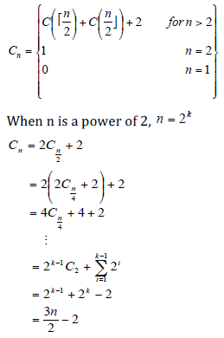

Slide 12
Worksheet No. 13

